Slide 1
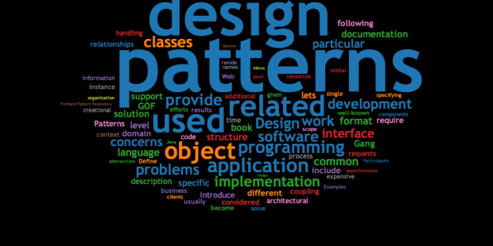
Design Patterns
academy.zariba.com

Slide 2
Lecture Content
What are Design Patterns?
Creational
Structural
Behavioral
Architectural
Design Patterns in Game Development

Slide 3
1. What are design patterns?
Design Patterns are general and reusable solutions to common problems in software design – problem/solution pairs within a given context
They do NOT provide a finished solution – only a template/recipe for solving certain problems
Patterns help with application design, abstractions, relationships between classes
Patterns are NOT concerned with algorithm or specific implementation
Design Patterns have a name, problem, solution and consequences when using them

Slide 4
1. Types of patterns
Creational – deal with initializing and configuring classes and objects
Structural – describe ways to assemble objects to implement a new functionality
Behavioral – deal with dynamic interactions among societies of classes and objects and how they distribute responsibility
Architectural – describe the architecture (clearly) or design of your applications

Slide 5
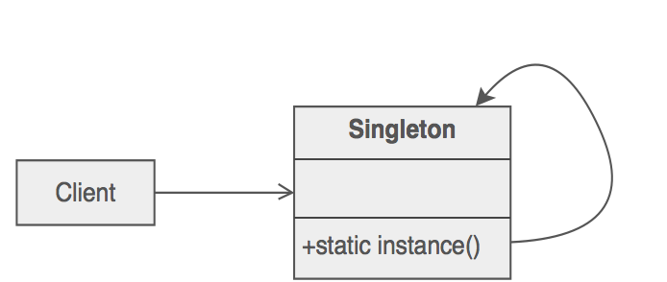
2. Creational – Singleton
Problem – A class needs to have a single instance throughout the application
Intent – Ensures that a class has only one instance and provides a global access to it
Solution (C#) – Create a static class
Solution (non-C#) – Create a class with a private constructor and instantiate the class in a property
Examples – Calculator

Slide 6
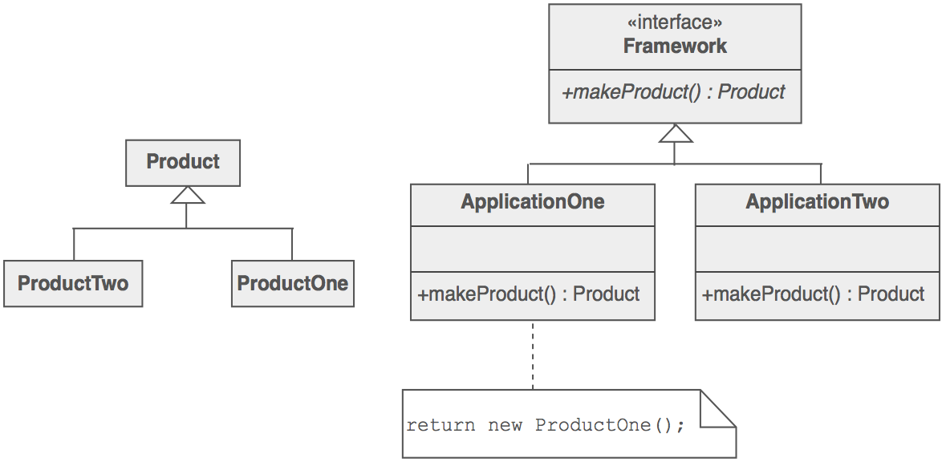
2. Creational – Factory Method
Problem – A framework needs to standardize the architectural model for creation of objects, but allows for individually selecting how to instantiate the objects
Intent – Define an interface for creating an object, but let subclasses decide which class to instantiate
Solution (C#) – Create a Template method for creating your object
Examples – Coffee Machine, Pizza rest.

Slide 7
2. Creational – Abstract Factory
Problem – Abstract object creation, create a family of related objects
Intent – Provide an interface for creating families of related or dependent objects without specifying their concrete classes
Solution (C#) – Create a Template Factory for creating your specific factories
Examples – Subway, SandwitchCo+Delivery

Slide 8
2. Creational – Builder
Problem – Producing a complex object with many parameters, which are order-dependent
Intent – Separates the construction of a complex object from its representation so that the same construction can create different representations
Solution (C#) – Create a Template method for creating your object
Examples – GTA vehicles, Subway sandwich in order

Slide 9
2. Creational – Prototype
Problem – Cloning objects
Intent – Creates new objects by copying the prototype
Solution (C#) – Inherit and implement the ICloneable interface
Examples – Graph Theory example from previous lecture

Slide 10
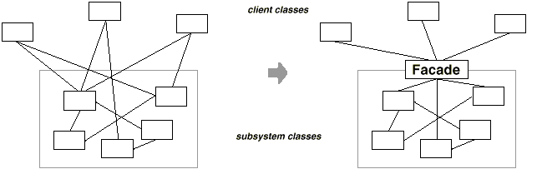
3. Structural – Facade
Problem – The client needs a simplified interface to the overall functionality of a complex subsystem
Intent – Provides a unified interface to a set of interfaces in a subsystem. Wraps a complicated sybsystem with a simpler interface
Solution (C#) – Inherit and implement the ICloneable interface
Examples – Universal remote control

Slide 11
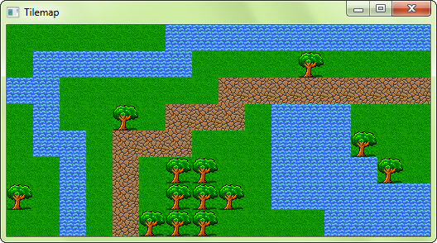
3. Structural – Flyweight
Problem – Designing objects formed by multiple similar smaller objects
Intent – Reduces storage costs
Solution – Create your objects by inserting repeated smaller objects
Examples – TileMaps in Games

Slide 12
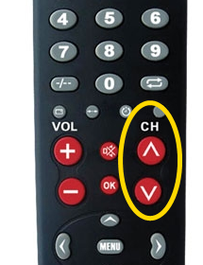
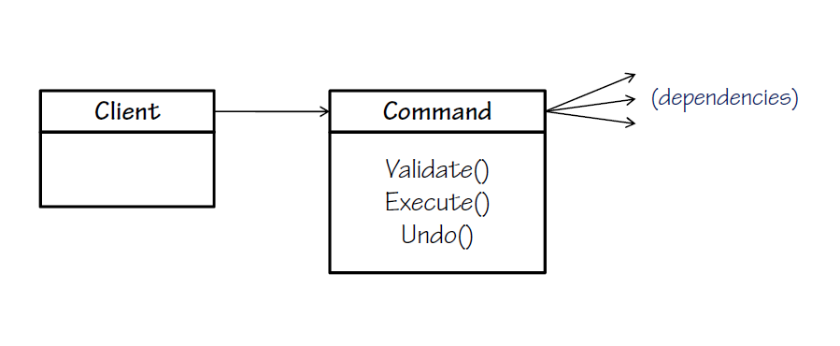
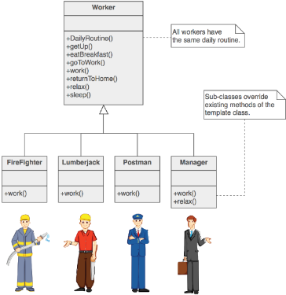
4. Behavioral
Iterator – access the elements of a complex object without revealing its actual representation (IEnumerable interface)
Command Pattern – an object encapsulates all the information needed to call a method a later time
Template – defines the base of an algorithm in a method, leaving some implementation to the subclasses.

Slide 13

5. Architectural – Client-Server

Slide 14
5. Architectural – MVC
Model-View-Controller (MVC) architecture separates the logic from the data and presentation
Model – Keeps the application state (data)
View – Displays the data to the user (UI)
Controller – handles the interaction with the user and logic

Slide 15
6. Design Patterns in Game Development
Builder - set up component-based entity one component at a time, based on data
Factory Method - create NPCs or GUI widgets based on a string read from a file
Prototype - store one generic 'Elf' character with initial properties and create Elf instances by cloning it.
Adapter - incorporate an optional 3rd party library by wrapping it in a layer that looks like your existing code. Very useful with DLLs.
Composite - make a scene graph of renderable objects, or make a GUI out of a tree of Widgets
Façade - simplify complex 3rd party libraries by providing a simpler interface to make your life easier later.
Flyweight - store the shared aspects of an NPC (eg. models, textures, animations) separately from the individual aspects (eg. position, health) in a mostly transparent way

Slide 16
6. Design Patterns in Game Development
Proxy - create small classes on a client that represent larger, more complex classes on a server, and forward requests via the network.
Chain of responsibility - handle input as a chain of handlers, eg. global keys (eg. for screen shots), then the GUI (eg. in case a text box is focused or a menu is up), then the game (eg. for moving a character)
Command - encapsulate game functionality as commands which can be typed into a console, stored and replayed, or even scripted to help test the game
Mediator - implement game entities as a small mediator class that operates on different components (eg. reading from the health component in order to pass the data to the AI component)

Slide 17
6. Design Patterns in Game Development
Observer - have the renderable representation of a character listen to events from the logical representation, in order to change the visual presentation when necessary without the game logic needing to know anything about rendering code
State - store NPC AI as one of several states, eg. Attacking, Wandering, Fleeing. Each can have its own update() method and whatever other data it needs (eg. storing which character it is attacking or fleeing from, the area in which it is wandering, etc.)
Strategy - switch between different heuristics for your A* search, depending on what sort of terrain you're in, or perhaps even to use the same A* framework to do both pathfinding and more generic planning
Template method - set up a generic 'combat' routine, with various hook functions to handle each step, eg. decrement ammo, calculate hit chance, resolve hit or miss, calculate damage, and each type of attack skill will implement the methods in their own specific way

Slide 18

References
Design Patterns in Gaming
Design Patterns explanation

Slide 19



Zariba Academy
Questions

